Slide 1


Data Lake Value Proposition
Medical Data Processing Company
Nermin Khalifa
Udacity IPS Version 1.0
Notes:
Hi, in this presentation we will provide an overview of data lakes, and how we architect a design for the medical data processing system.
This presentation prepared and presented by myself Nermien Khalifa

Slide 2
Agenda
What is a Data Lake
Components of a Data Lake
Data Lake vs Data Warehouse
Business Value of Data Lake Solution
Proposed Data Lake Architecture for Medical Data Processing system
Udacity IPS Ver. 1 2/2020
Notes:
We will go through some points:
First, we will define the data lakes and enumerate and explain their components .
Then, we will clarify the differences between data warehouse and data lake.
After that, we will discuss the business value of data lake solution.
Finally, we will show the architected design proposed for the medical data company.

Slide 3

What is a Data Lake
Executive summary
https://www.stitchdata.com/resources/what-is-data-lake/
Notes:
So what is a data lake?
A data lake is a centralized repository designed to store, process, and secure large amounts of structured data comes in rows and columns like relational databases, OR semi-structured data such as hierarchical web content, OR unstructured data like text documents , videos or images
It can store data in its native format and process any variety of it, ignoring size limits.
This flexibility means that enterprises can upload anything from raw data to the fully aggregated analytical results.
In short, the data lakes are considered as the raw big data stores, not optimized or transformed for specific data consumers.

Slide 4
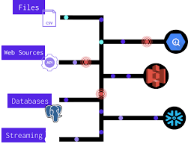
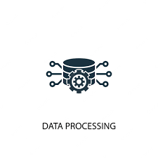


Components of Data Lake
Ingestion
Storage
Processing
Serving
Notes:
The main components of any data lake are (ingestion layer , storage layer, processing layer and serving layer) we will talk about each layer briefly
Ingestion layer: on the left side, the image depict different data sources, this data could be loaded into the data lake in batches or in real-time.
Storage layer: Data storage should be scalable, offers cost-effective storage and allow fast access to data exploration. and The important thing is that It should support various data formats.
Processing layer is responsible for running analytical algorithms and users queries with varying real time, interactive, batch to generate structured data for easier analysis.
Finally, the Serving layer is responsible for presenting data to users. it should provide tools through which users can access data.
Another point to consider is that The most significant risk of data lakes is security and access control Sometimes data can be placed into a lake without any oversight, and some of the data may have privacy and regulatory need.

Slide 5
Data Lake vs Data Warehouse
Two Different Approaches
Depending on the requirements, a typical organization may require both a Datawarehouse and a data lake as they serve different needs and use cases.
Notes:
< You will complete this information on the next slide. Please provide at least 3 items for each. No need to add any content on this slide >

Slide 6
Data Warehouse
Data Lake
Data: Relational from transactional systems, operational databases, and line of business applications(focuses only on Business Processes.)
Storage: Expensive storage that give fast response times are used
schema-on-write (predefined schemas)
Highly curated data (central version of the truth)
Users: Business analysts
Analytics: Batch reporting, BI and visualizations
Tools: Mostly commercial tools.
Data: Non-relational and relational from IoT devices, web sites, mobile apps, social media, and corporate applications.
Storage: Data lakes design for low-cost storage.
schema-on-read (no predefined schemas)
Any data that may or may not be curated (ie. raw data)
Users: Data scientists, Data developers, and Business analysts (using curated data)
Analytics: Machine Learning, Predictive analytics, data discovery and profiling
Tools: Can use open source/tools like Hadoop/ Map Reduce
Udacity IPS Ver. 1 2/2020
Notes:
As you can see from this comparison the Data lake: A data lake contains all an organization's data in a raw, unstructured form, and can store the data indefinitely — for immediate or future use cost effective, on the other hand, A data warehouse contains structured data that has been cleaned and processed, ready for strategic analysis based on predefined business needs

Slide 7
Business Value of Data Lake
In general :a data lake is not only about storing full-fidelity data. It’s also about users gaining a deeper understanding of business situations because they have more context than ever before, allowing companies to accelerate analytics experiments.
Medical Data Processing Company needs data lake solution:
1- To keep unlimited historical data
2- To keep different formats
3- To integrate with different ML frameworks such as TensorFlow, to create dashboards using tools such as PowerBI, Tableau, or Microstrategy and to Generate daily, weekly, nightly reports using scripts or SQL
4- To use low cost storage (pay as you go) and open source tools.

Slide 8
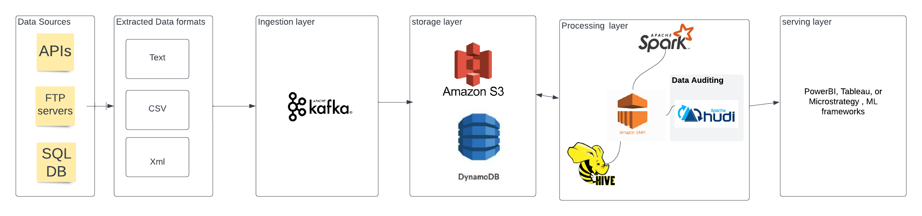
Data Lake Architecture
< Video tip: You can also use additional slides to briefly elaborate or highlight any area from your architecture. You can also choose where to include this slide.

Slide 9
THANK YOU
Udacity IPS Version 1.0

Slide 10
Resources
https://cloud.google.com/learn/what-is-a-data-lake
https://www.stitchdata.com/resources/what-is-data-lake/

